Slide 1

Light and darkness about future techology

Slide 2
1º DAW

Slide 9

Artificial intelligence is a program which aims to
create machines (robots) that have the ability
to reason and think like humans.

Slide 10
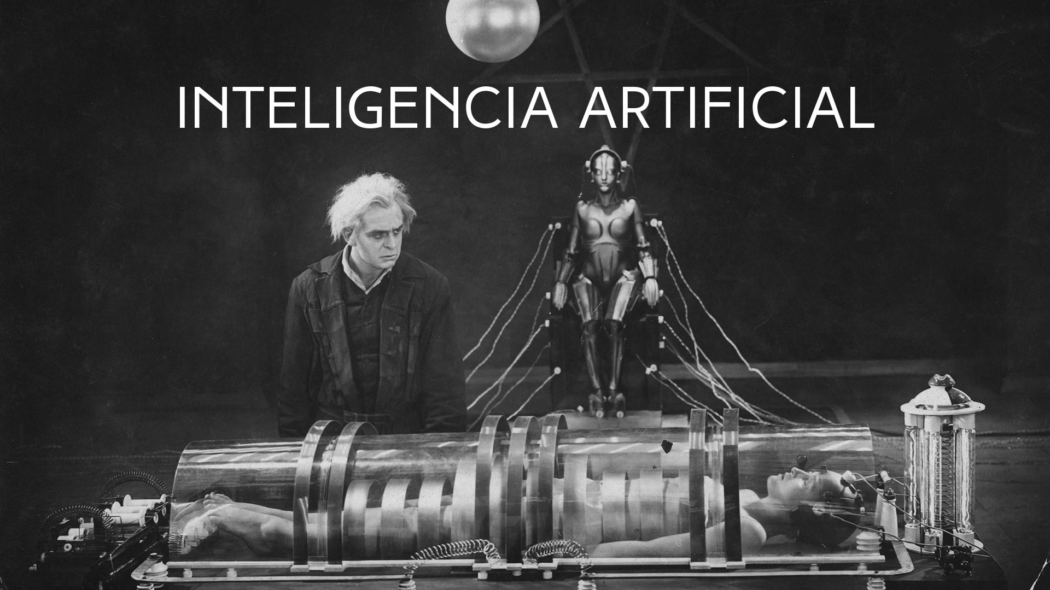
THERE ARE DIFFERENT ANSWERS WHY CAN NOT KNOW THE FUTURE AND CAN NOT KNOW WHAT WILL HAPPEN .
THERE ARE DIFFERENT ANSWERS WHY CAN NOT KNOW THE FUTURE AND CAN NOT KNOW WHAT WILL HAPPEN .
THERE ARE DIFFERENT ANSWERS WHY CAN NOT KNOW THE FUTURE AND CAN NOT KNOW WHAT WILL HAPPEN .
ARTIFICIAL INTELLIGENCE
There are different answers why can not know the future and can not know what will happen.

