Slide 1
Lights and Darkness: Future technoligies
By: Adelin, Sandra Alcaraz, Madalina and Lucía Carrillo

Slide 5
Question 6: One day we won´t the sky by the agreat amount of ligth that there will be

Slide 6
Question 10: In the future technology developments will stop

Slide 7
Question 11: Do you think that there will be a bionic eye that will give sight to the blind people?

Slide 8
Opinion

Slide 9
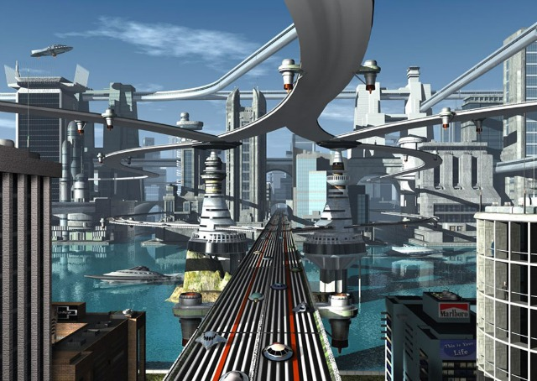
THE END
THANKS FOR WATCHING ☺

